Slide 1
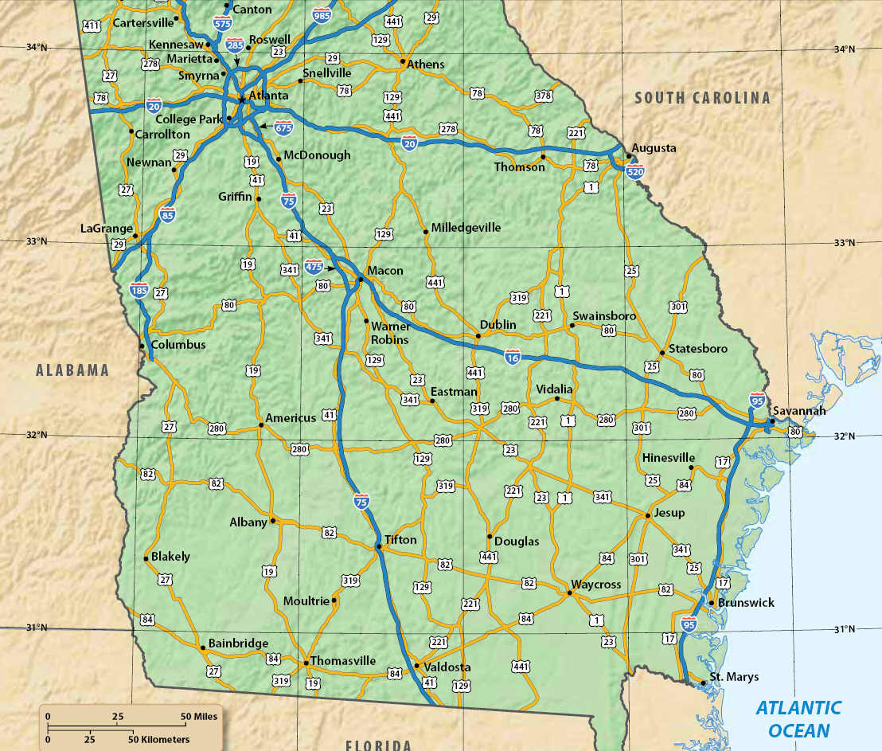
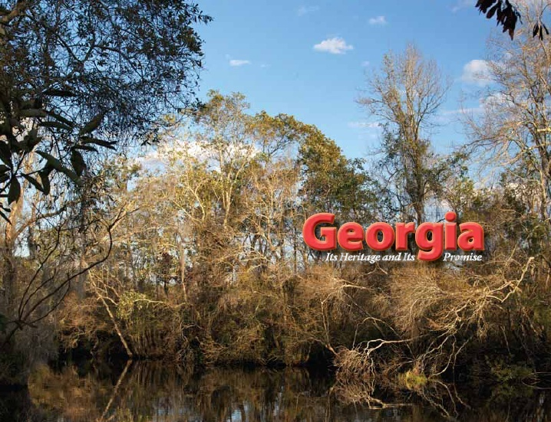
Chapter 12:
Georgia in the American Revolution
STUDY PRESENTATION
© 2010 Clairmont Press

Slide 2
Section 1: Georgia in the Early Days of the Revolution
Section 2: Georgia in the Latter Part of the Revolution

Slide 3

CH 12, Section 1: Georgia in the Early Days of the Revolution
Essential Question:
  What was war in Georgia like during the first years of the American Revolution?
What terms do I need to know?
  neutral
  faction
  radical
  conservative
  siege

Slide 4
CH 12, Section 1: Georgia in the Early Days of the Revolution
The war reached Georgia’s coast in January 1776, when British navy vessels arrived at the mouth of the Savannah River.
The British wanted to buy Georgia rice for their troops. Georgia’s Patriots and the Council of Safety in Savannah arrested the governor and royal officials and then placed them on parole (a conditional surrender).
Georgia’s Patriots formed two military groups: Militia (citizen-soldiers) and Continental troops (funded by the Continental Congress).

Slide 5
Battle of the Rice Boats
The Battle of the Rice Boats – also called the Battle of Yamacraw Bluff – left Georgia in the hands of the revolutionaries.
Governor Wright and his family and other royal officials escaped to the British ships.
The British troops successfully captured some boats loaded with rice.
The Patriots believed they had saved Savannah.

Slide 6
Establishing a State Government
Georgia revolutionary leaders established a provincial congress in 1776.
Patriots controlled the government.
Executive branch consisted of Council of Safety and its president; Judicial branch had a court with chief justice and two assistants.
From March 1776 (when British troops left Georgia) until British troops returned in December 1778, the revolution in Georgia was basically a civil war fought between Georgia’s Patriots and Loyalists.

Slide 7
Native Americans and the War
The Indians in Georgia were caught between the warring whites.
Most traders became loyalists and urged the Indians to fight with the British.
George Galphin, a Patriot trader, tried to keep the Indians neutral (to not take sides in the war).
The Patriots did not have many goods to give the Indians, and most Indians who fought sided with the British and the loyalist traders.

Slide 8
Patriot Factions: McIntosh & Gwinnett
Colonel Lachlan McIntosh commanded the Georgia battalion of the Continental Army, and took responsibility for Savannah’s defense.
McIntosh was part of a faction (group) from the Savannah area that wanted independence and to limit who could serve in government.
Another faction, which wrote the state’s new constitution, wanted ordinary people to have more say in a government independent from Great Britain. Button Gwinnett belonged to this group.

Slide 9
GA Constitution of 1777
Georgia’s 12 colonial parishes became 8 counties.
The counties took over the work of local government.
A new state constitution in 1777 created a unicameral legislature “composed of the representatives of the people.”
Radical Patriots (those who wanted the most change) supported this constitution and its democratic language.

Slide 10
GA Constitution of 1777
Conservatives (those who wanted less change) thought the constitution made too many “ordinary” men eligible to vote and hold office.
Georgia’s governor had limited power and could only serve a single one-year term – the legislature held almost all of the power; first was John Adam Treutlen, a Salzburger descendant.

Slide 11
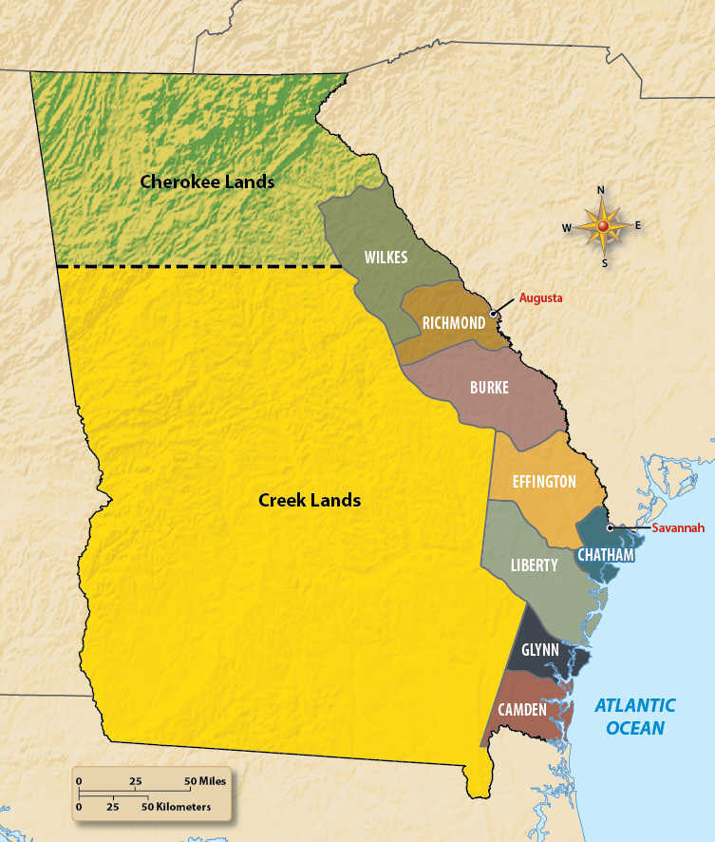
Original Georgia Counties
1777
Which county was named in the honor of the Revolution?

Slide 12
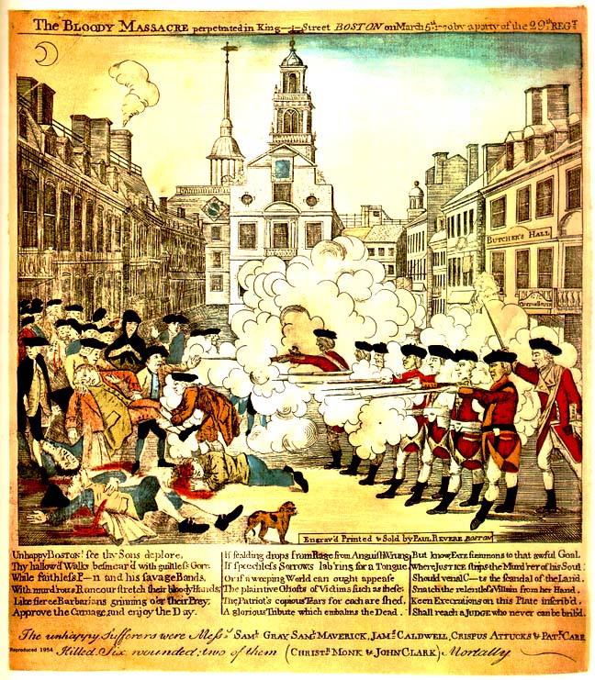
Remember this piece of propaganda?

Slide 13
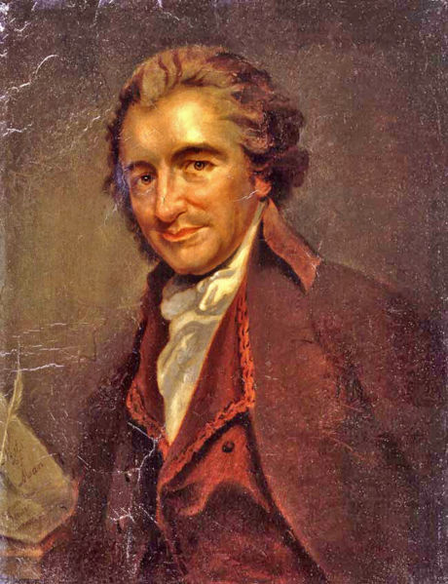
Thomas Paine: Common Sense
Pamphlet that was widely read in the colonies.
Made independence sound like “common sense.”

Slide 14
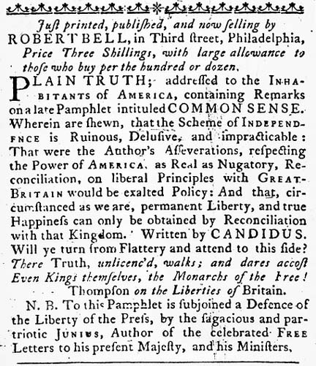
James Chalmers: Plain Truth

Slide 15
CH 12, Section 2: Georgia in the Latter Part of the Revolution
Essential Question
  What was Georgia’s role during the latter part of the American Revolution?
What term do I need to know?
  siege

Slide 16
Battle of Saratoga (NY)
Turning point of the Revolutionary War
Major patriot victory of General Gates over General Burgoyne
France allied with the United States after this battle, now believing that the patriots could actually win.
http://www.history.com/topics/american-revolution/battle-of-saratoga

Slide 17
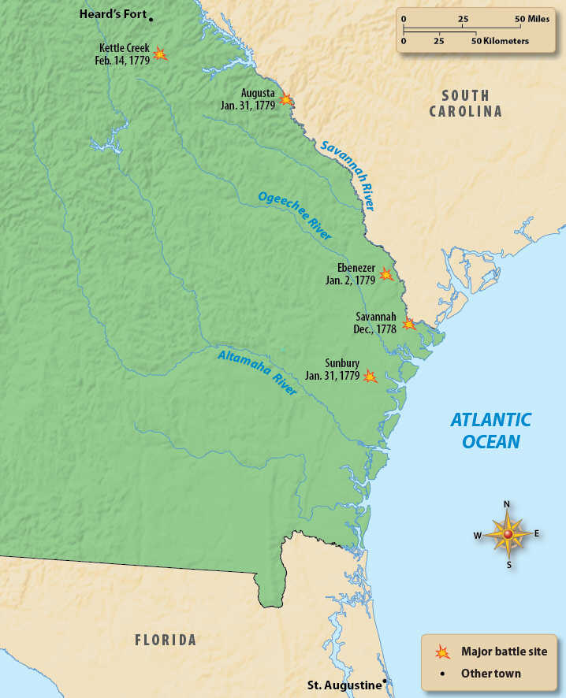
The Fall of Savannah, Sunbury, & Augusta
Sir Henry Clinton led the British to easily capture Savannah in December 1778.
The Georgia Patriot government fled.
The British offered to pardon all Patriots who would take an oath of allegiance to the King.
By January 31, Augusta and Sunbury were under British control.
The British reestablished a royal government in Savannah.

Slide 18
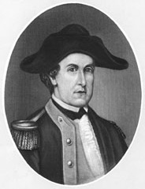
The Battle at Kettle Creek
On February 14, 1779, rebel forces surprised a Loyalist camp at Kettle Creek, northwest of Augusta.
Patriot militia led by Andrew Pickens, John Dooly, and Elijah Clarke surrounded the Loyalist camp.
Austin Dabney, a mulatto slave, was wounded and later honored for “bravery and fortitude,” and was granted land.
Kettle Creek won the militia much needed supplies, ammunition, and horses, and lifted their morale. The backcountry remained in Patriot control.
Elijah Clark
Link: Austin Dabney’s land grant.

Slide 19
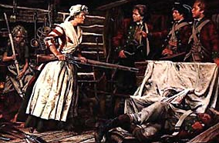
The War in the Backcountry
Bands of Patriots and Loyalists roamed the backcountry, raiding homes. Families were sometimes murdered and crops burned.
The stories of Nancy Hart center on a Patriot wife and mother who became legendary in defense of her home against a group of Loyalists. Nancy Hart legends and stories became popular in the mid-1800s.
Link: Nancy Hart

Slide 20
Video Clip: Bet You Didn’t Know!
http://www.history.com/topics/american-revolution/american-revolution-history/videos/bet-you-didnt-know-revolutionary-war?m=528e394da93ae&s=undefined&f=1&free=false

Slide 21
The Siege of Savannah (1 of 2)
The French arrived with 22 ships and 4,000 troops in September 1779 to liberate Savannah.
French Commander Count D'Estaing demanded Savannah’s surrender, but British General Augustine Prevost delayed and then refortified his defenses.
Polish nobleman Count Casimir Pulaski fought and died for the Patriots here.

Slide 22
The Siege of Savannah (2 of 2)
The French & Patriots began a three-week siege of Savannah. They surrounded and bombarded the city. They tried to prevent supplies from reaching it.
By the end of October, the British and Loyalists in Savannah celebrated their victory.
The Battle of Savannah was the second bloodiest battle of the Revolution.
By May 1780, both Savannah and Charleston, the South’s two major ports, were in British hands.

Slide 23
The Battles for Augusta
Lieutenant Colonel “Lighthorse Harry” Lee worked with Lt. Colonel Elijah Clarke of Georgia and General Andrew Pickens of South Carolina took Augusta and captured British supplies.
The Patriots regained control of Augusta by June 1781 and the Patriot government returned.

Slide 24
The End of the War
  In October 1781, British General Cornwallis surrendered his entire army at Yorktown, Virginia to Gen. George Washington (commander of the Continental Army)
  http://www.history.com/topics/american-revolution/siege-of-yorktown/videos/1781-victory-at-yorktown-helps-end-the-american-revolution
  Savannah was still in British control, but the royal government in Georgia was ordered to evacuate.
  In July 1782, British troops & government officials, and hundreds of loyalists, left in ships.
  The Georgia Patriot government began governing.
  Treaty of Paris (1783) officially recognizes the United States as an independent nation.

Slide 25
Chapter 12 Review: The Revolutionary War

Slide 26
What is the difference between a patriot and a loyalist?

Slide 27
What were the first battles of the American Revolution?

Slide 28
What was the outcome of the Battle of the Rice Boats?

Slide 29
With which side did MOST Indians align during the war?

Slide 30
Under the Georgia Constitution of 1777 which part of the government held almost all of the power?

Slide 31
Who led American troops at the Battle of Kettle Creek?

Slide 32
What African American was honored for his bravery at the Battle of Kettle Creek?

Slide 33
What did the patriot militia get out of their victory at Kettle Creek?

Slide 34
What was Nancy Hart known for during the Revolution?

Slide 35
What nation came to the side of the patriots after the Battle of Saratoga?

Slide 36
What was the result of the Siege of Savannah?

Slide 37
What was the final major battle of the war, in which General Washington defeated General Cornwallis?

Slide 38
How many counties were created out of the 12 parishes in the Georgia Constitution of 1777?

Slide 39
Why was the governor kept VERY weak under the Georgia Constitution of 1777?

Slide 40
Return to Main Menu

