Slide 1
Chapter 13:
Georgia from Confederation to Constitution
STUDY PRESENTATION
© 2010 Clairmont Press

Slide 2
Section 1: Georgia Under the Confederation Government
Section 2: Georgia’s Economic, Educational, and Religious Development
Section 3: Creating a New Constitution
2

Slide 3
10/26/17
Essential Question: How did Georgia and the United States rebuild its’ governments following the American Revolution?
Agenda:
Video: http://www.history.com/topics/articles-of-confederation/videos/america-gets-a-constitution
Readers Theatre
https://www.youtube.com/watch?v=3KGG9afW7XY
https://www.youtube.com/watch?v=q77iwGlyXF4
Notes

Slide 4
Section 1: Georgia Under the Confederation Government
Essential Question
How did Georgia rebuild its state and government following the American Revolution?

Slide 5
Section 1: Georgia Under the Confederation Government
What terms do I need to know?
Articles of Confederation
unicameral
credit
tuition
Great Compromise
United States Constitution
Electoral College
federalists
antifederalists
Bill of Rights
secede

Slide 6
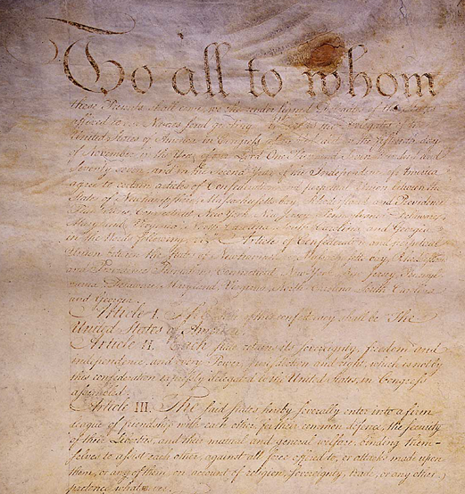
The Articles of Confederation
In 1781, the states formed a confederation.
The states maintained the power to govern; the central government was limited to actions needed by all the states.
The Articles of Confederation document outlined the duties of the Confederation government.
There was no executive branch or court system.
A unicameral (one house) system formed committees to perform specific tasks.
State governments most affected citizens of each state.
This is a portion of the first page of the Articles of Confederation. Photo: U.S. Government Printing Office
Link: Ben’s Guide article on the Articles of Confederation.

Slide 7
Georgia’s Government
Georgia’s government at the end of the war was based on the Constitution of 1777.
A governor and a council shared executive powers. The governor could not veto.
The legislature held most of the power.
Superior court in each county oversaw elections, controlled roads, and provided aid for the poor.
Special assemblies addressed specific needs or problems, such as rebuilding farms and buildings, and establishing relationships with the Creek and the Cherokee.

Slide 8
Land
Land was the most important issue for most Georgians after the war.
A farmer with land could support his family; planters could grow cash crops and become wealthy.
Many Loyalists tried to return to Georgia and their lands; some succeeded, but others who had actively opposed the Patriot cause were not permitted.
Soldiers who had fought in Georgia for independence could receive bounty grants of 200 or more acres. The “headright” grant also allowed 50 more acres for each additional household member, which further encouraged settlement.
In 1786, a new town of Louisville was ordered built on the Ogeechee River; it was to be Georgia’s new capital.

Slide 9
Indian Relations
Settlers soon began filling up lands the Indians had given up in treaties of 1763 and 1773.
The Cherokees agreed to give up some additional lands in meetings that took place in 1782 and in Augusta in 1783.
The Upper Creek, led by Alexander McGillivray, did not want to cede more land. He and his followers refused to accept the 1783 Treaty of Augusta.
The Creek land issues had not been settled by the late 1780s.

Slide 10
Finances
Georgia had little money after the war and a lot of debt.
Sale of land confiscated from Loyalists, especially rice planters, was to be a key income source.
The Confederation could not tax, but did ask each state for money to help pay the national debt.
Land tax collections were slow, but over several years the financial problems improved.
Return to Main Menu

Slide 11
Section 2: Georgia’s Economic, Educational, and Religious Development
Essential Question
What factors affected economic, educational, and religious development in Georgia after the Revolution?

Slide 12
Section 2: Georgia’s Economic, Educational, and Religious Development
What terms do I need to know?
credit
tuition

Slide 13
The Economy in Georgia
Labor shortages for cash crops such as rice increased the demand for slaves.
Many planters bought slaves on credit, paying for them over time.
Tobacco became the most profitable crop of the late 1700s.
Most farmers in the interior grew food crops, and raised cattle, hogs, and chickens.
Craftsmanship and trade reemerged in Georgia towns after the war.
Tobacco crops are still an important part of the economy of southern states. Photo: U.S. Department of Agriculture.

Slide 14
Education in Georgia
Free public education for the state’s children did not exist in the 1780s; most of Georgia’s education remained private. Schools charged tuition (a fee for instruction).
In 1785, the state of Georgia charted the University of Georgia; the nation’s first state-supported university.
Abraham Baldwin, a signer of the Declaration of Independence, wrote the charter.
The University’s purpose was to educate leaders for the state, whatever their religious affiliation.
The University of Georgia held its first classes in 1801.
This archway marks the northern boundary of the campus of the University of Georgia. Photo: UGA staff

Slide 15
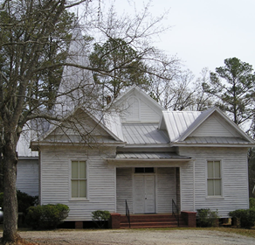
Religion in Georgia
The Methodists, formerly a group within the Anglican Church in England, became the Methodist Episcopal Church in America.
The Methodists held their first conference in Georgia in 1788.
The Baptists founded several churches throughout the Georgia backcountry in the 1770s and 1780s.
Baptist and Methodist churches grew quickly in the state’s rural, frontier areas. The Baptists encouraged independent churches; the Methodists had ministers who rode circuits, connecting one church to another through districts and conferences.
The state’s oldest independent black churches are in the Augusta area.
The Powelton Baptist Church was founded in 1786. It is located in Hancock County, Georgia (originally, Greene County).
Return to Main Menu

Slide 16
Section 3: Creating a New Constitution
Essential Question
How did Georgians think their lives would be improved by a new United States Constitution?

Slide 17
Section 3: Creating a New Constitution
What terms do I need to know?
Great Compromise
United States Constitution
Electoral College
Federalists
antifederalists
Bill of Rights
secede

Slide 18
Problems Under the Articles of Confederation
The government needed more power to tax so it could pay its debts and keep the respect of other countries.
The U.S. needed a strong central government to negotiate effectively with Great Britain, France, and Spain.
The government had problems in relationships with the Indians who were determined to hold on to their homelands.
Having no executive to carry out government functions posed a problem.
It was difficult to pass measures with a two-thirds majority required.

Slide 19
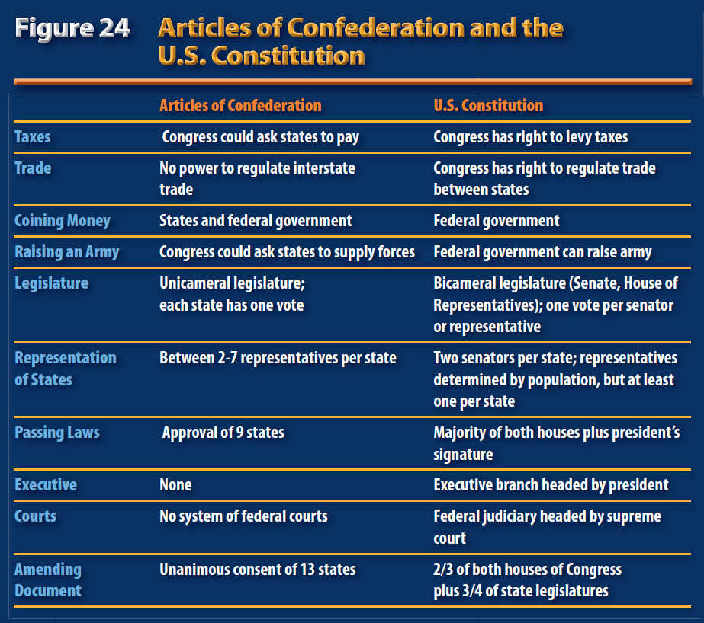
Articles vs. Constitution

Slide 20
The Constitutional Convention
Held in May 1787 in Philadelphia and attended by representatives from 12 states; Rhode Island did not send delegates.
William Few, Abraham Baldwin, William Pierce, and William Houstoun attended from Georgia.
The Great Compromise established a Senate with two representatives from each state, and a House of Representatives with representatives selected based on state population.
The new Congress could tax and regulate trade.
An executive branch would include a president and vice president who could carry out and enforce laws.
An electoral college of electors from each state would vote for the president and vice president.
A judicial branch would interpret the laws as needed.
Link: United States Constitution

Slide 21
Ratification of the Constitution
Georgia was the 4th state to ratify (approve) the U.S. Constitution. It voted to approve it after two days of debate.
Georgians feared a war with the Creek and felt a stronger national government would offer more protection and negotiate with more strength.
Planters and merchants wanted the new government to negotiate better trade treaties and to help regulate trade.
Abraham Baldwin won planter support by helping pass a clause to allow the slave trade to continue for another 20 years.

Slide 22
Constitutional Ratification Issues
Unlike Georgia, some states did not easily support ratification of the Constitution.
Antifederalists included small farmers who preferred that power remain in nearby state governments. They worried about citizens’ rights.
Federalists like Alexander Hamilton wrote essays to explain the Constitution and how it would work; The Federalist Papers were widely read.
The Bill of Rights, the first 10 amendments to the Constitution, guaranteed citizens’ rights. By 1790, all 12 states had joined the United States of America.
Georgia wrote a new state constitution in 1789 that established a state government similar to the federal government that was created in the U.S. Constitution.

Slide 23
Return to Main Menu

