Slide 1
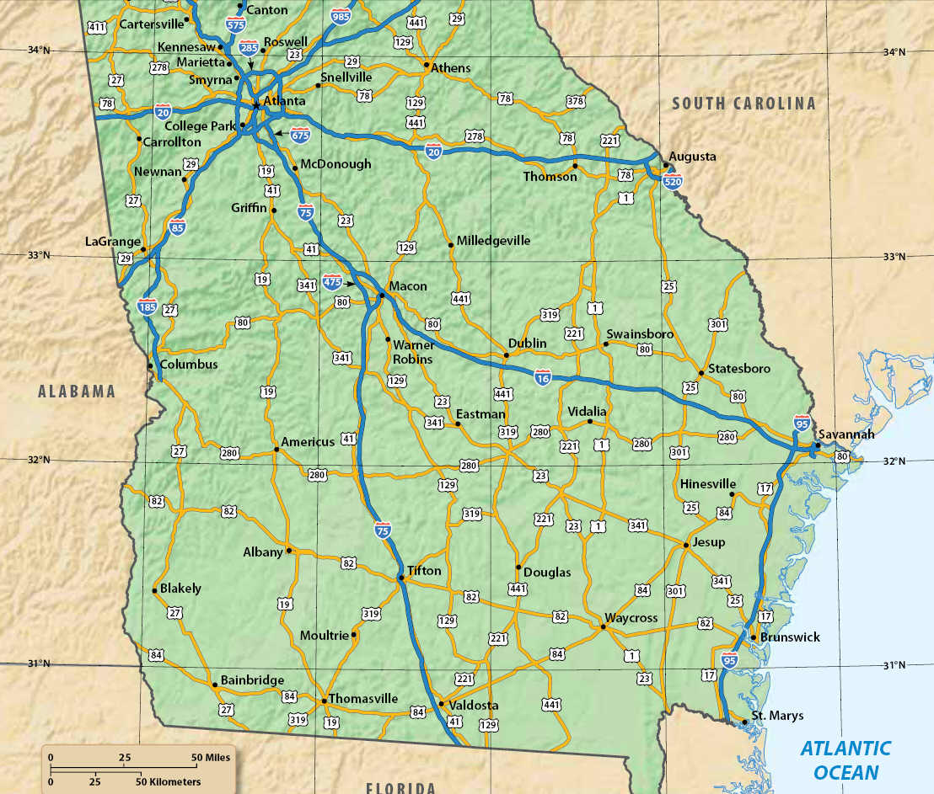
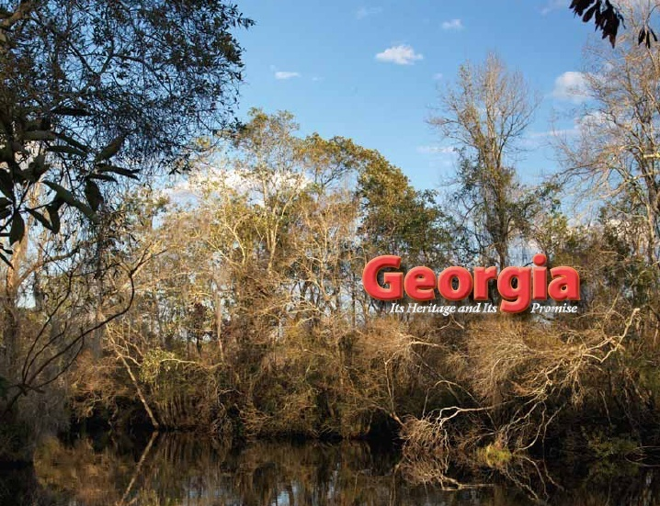
Chapter 18:
Bourbons, Populists, and Progressives
STUDY PRESENTATION
© 2010 Clairmont Press

Slide 2
Section 1: Bourbon Democrats and Independents
Section 2: Farmer Discontent and Populism
Section 3: Progressivism in Georgia

Slide 3
Chapter 18, Section 1: Bourbon Democrats and Independents
Essential Question
How did the Bourbon Democrats control Georgia politics during this period?
What terms do I need to know?
Bourbon Triumvirate

Slide 4
Bourbon Democrats and Independents
The Democrats controlled Georgia by the end of Reconstruction in 1877.
Politicians tried to control the African American vote with intimidation.
These politicians wanted whites to support the Democratic Party and remain united. They did not want southern whites to lose their political and economic power.
In the 1890s, the Populists called on white and black farmers to challenge the Democratic Party power structure.

Slide 5
The Bourbon Triumvirate
Democrats controlled Georgia in the decades following Reconstruction. Their opponents called them “Bourbons,” a term that referred to a royal French family that never learned from the past, but also never forgot the past.
Three men controlled the governor’s office and Georgia’s two Senate seats from 1876 to 1890: Joseph E. Brown, Alfred B. Colquitt, and John B. Gordon. They became known as the Bourbon Triumvirate (a group of three in authority).

Slide 6
The Bourbon Triumvirate
The Bourbon Triumvirate controlled Georgia. They supported “Lost Cause” ideas (maintaining white supremacy and pre-Civil War states’ rights), but also supported business, the railroads, bringing industry to GA, diversifying agriculture, and other “New South” issues.
Republicans joined with Independent voters in trying to defeat the Democrats.

Slide 7
Challenges to the Bourbons
The Independents elected three members to the U.S. Congress by the early 1880s, but could not unseat the Democrats from the governor’s office or the Senate.
By the 1890s, the power of the Bourbon Triumvirate began to fade.
The Bourbons were conservatives with money and believed in less government spending on public services – services that the middle and lowers classes needed.
Struggling middle class and poor farmers became more discontented with economic issues and eventually formed a political party to work for major reforms.

Slide 8
Chapter 18, Section 2: Farmer Discontent and Populism
Essential Question
How did populism affect the politics of Georgia in the late 19th century?
What terms do I need to know?
Farmers’ Alliance
co-op
graduated income tax
Populist Party
fraud
county unit system

Slide 9
Farmer Discontent and Populism
In the late 1880s, cotton prices dropped as prices increased for the goods that Georgia’s middle-class and poor farmers needed to buy.
Railroad shipping costs paid to send farmers’ products to market also contributed to their financial struggles.
Many owners of small farms sold their land to pay debts. Some eventually became tenant farmers or sharecroppers.
As farmers became more discontented by the policies of the Bourbon Democrats, they organized their own political party.

Slide 10
The Farmers’ Alliance
Farmers could gather for friendship and discuss common problems and issues.
Farmers joined in cooperative buying stores, or co-ops to lower the price of goods.
The Farmers’ Alliance in Georgia began to get involved in politics and sought reforms, including working for a graduated income tax so that wealthier Georgians would pay their “fair share” of income taxes.
Alliance membership fell by the early 1890s, as farmers began to see the Alliance as politically ineffective.

Slide 11
The People’s (Populist) Party (1/2)
The Populist Party believed in “rights and powers of the common people in their struggle with the privileged elite.”
Tom Watson became a national Populist leader from Georgia, including being a Populist Party vice-presidential and presidential candidate. He supported public education and the end of the convict lease system.
Watson was elected to the U.S. House of Representatives in 1890, but later lost reelection.

Slide 12
The People’s (Populist) Party (2/2)
Watson sponsored legislation creating RFD (Rural Free Delivery).
The Populists tried to pass reforms that benefitted both black and white farmers.
Democrats maintained most of the power during this time; in some places, voting fraud (dishonest voting) took place.

Slide 13
One-Party Rule
Populism had stirred up racial tensions in Georgia. White Populists initially had appealed to African American farmers to join them, but that changed.
A movement began to find ways to keep African Americans completely out of the political process in Georgia.
As Populism ended, Georgia was basically a one-party state with the Democrats in firm control for decades.

Slide 14
County Unit System
In the late 1890s, candidates in Democratic Party primaries were chosen by the votes of each county, not by the overall popular vote (called county unit system).
Rural counties always outvoted the urban counties because there were more rural counties.
This system gave less-populated rural counties more political power than more populated counties (and generally kept power in the hands of rural whites).
The county unit system didn’t change until 1962 after the U.S. Supreme Court ruled (Baker v. Carr) that each person’s vote should count equally.

Slide 15
Georgia’s County Unit System
How might a state-wide election today have different results under this system?

Slide 16
Chapter 18, Section 3: Progressivism in Georgia
Essential Question
How did urban progressive reforms in Georgia develop after rural-centered populism faded?
What terms do I need to know?
progressivism
suffrage
Nineteenth Amendment

Slide 17
Progressivism in Georgia
Progressivism originated in the cities. Urban, middle class, educated men and women called for reforms. They identified problems brought on by industrialization and urbanization.
Reform areas included child labor, prison reform, women’s suffrage and temperance/prohibition.
http://www.history.com/topics/prohibition
The progressive movement in Georgia was more modest than in giant cities like New York.
Women’s voting was the progressive idea that affected the most Georgians.

Slide 18
Governor Hoke Smith and Progressivism Reform
Governor Hoke Smith was a reformer in the early 20th century. He established the State Board of Education, increased school funding, and founded the juvenile court system.
In 1908, Georgia ended the practice of leasing out prisoners to private businesses (convict lease system). Prisoners could still be used by governments to work on roads.
Other progressive reforms established the state’s Department of Commerce and Labor.

Slide 19
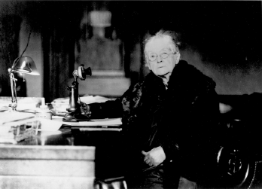
Women’s Suffrage
Rebecca Latimer Felton worked hard for women’s right to vote (suffrage).
She was concerned about poor girls being able to get an education. She also worked to make alcohol illegal (prohibition).
In 1918, Congress passed the 19th Amendment, which gave women the right to vote. Georgia did not ratify it, but by 1920 it became national law.
In 1922, Rebecca Felton became the first female senator in U.S. history.
Senator Rebecca Latimer Felton of Georgia was the first female to serve as a United States Senator. She was in office for 24-hours in 1922.
Image: U.S. Senate Historical Office

Slide 20
Return to Main Menu

