Slide 1
Chapter 20:
The Economy, Expansionism, and World War I
STUDY PRESENTATION
© 2010 Clairmont Press

Slide 2
Section 1: The Economy
Section 2: World War I

Slide 3
Section 1: The Economy
Essential Question
How did the “New South” concept change the way Georgians viewed their economy?

Slide 4
Section 1: The Economy
What terms do I need to know?
New South
diversify
truck farming
service industry

Slide 5
The Economy
The number of tenant farmers and sharecroppers continued to rise.
Most tenant farmers were African Americans, but more and more whites became part of that system.
Some southern leaders called for a New South that would become more economically progressive and prosperous.
Henry W. Grady, a journalist and editor of the Atlanta Constitution, was a leading spokesman for the New South and a great promoter of Atlanta during the 1880s.
Grady made speeches and wrote articles encouraging northerners to invest in the southern economy, especially in Atlanta. Some of Atlanta’s industrial growth during the late 19th Century can be attributed to Grady.

Slide 6
Agriculture
Cotton remained the major cash crop of Georgia, although peaches and pecans provided income for some Georgians.
Truck farming, or growing vegetables and fruits for market, grew in scale as railroads made it possible to ship goods before they began to rot.
Proponents of a New South called for farmers to diversify, or grow crops of different kinds; they called for “scientific” farming which they believed would strengthen Georgia’s economy.

Slide 7
Industrialization
“New South” supporter Henry Grady of the Atlanta Constitution worked to bring more manufacturing to Georgia.
International Cotton Exposition’s goal was to promote Georgia as a place to invest and do business
The industries that emerged and grew in Georgia during this pre-World War I period included sawmills that made board from Georgia pine trees and gristmills that ground corn and other grains.
Georgians also began producing naval stores from pine trees using new techniques to collect the sap.

Slide 8
Textiles
Major textile mills were built in the late 1800s in the Augusta and Columbus regions (fall line) to produce cloth from Georgia cotton.
The west-central area of Georgia saw textiles as a good economic development.
National expositions (fairs) in the 1880-90s (Cotton Expositions) showcased Georgia’s economic recovery, the state’s natural resources, and lured investors.
Many children worked long days in the mills, which kept them from attending school.
Textiles became the most important industry in Georgia.

Slide 9
New Businesses
The soft drink companies Coca-Cola and Royal Crown Cola were founded in Georgia during this period.
In 1886, Atlanta pharmacist John Pemberton invented Coca-Cola as a “health” drink made from the coca leaf and kola nut, mixed with bubbly water. Several families in Georgia towns became wealthy bottling and selling Coca-Cola. Coca-Cola was later purchased by Asa Candler and then by the Woodruff family.
Columbus pharmacist Claude Hatcher developed Royal Crown Cola in the early 1900s. In the 1920s, the company expanded into the fruit-flavored drinks called Nehi.

Slide 10
Tourism
The state’s service industries such as tourism grew, especially in the Golden Isles region of Georgia’s coast.
A groups of wealthy northerners built vacation homes on Jekyll Island. These individuals were attracted to the coastal region’s beauty and the state’s mild climate in the winter.
Golf retreats became popular in the Augusta area.
The Jekyll Island Club Hotel on Jekyll Island was once a private club for some of the world’s wealthiest businessmen.
Image: Public Domain
Link: Jekyll Island

Slide 11
Urbanization and Business
Georgia’s towns grew around the railroads.
Alonzo Herndon, a wealthy African-American businessman, owned many properties and founded the Atlanta Life Insurance Company. Herndon and his wife provided funding for many social service nonprofit organizations and Atlanta University.
Atlanta’s growing population led to more retail stores. Rich’s department store became a major attraction in downtown Atlanta.
Electricity came to Georgia’s cities by the early 1900s. It would be many more years before residents in many rural areas enjoyed the benefits of electricity.

Slide 13
Section 2: World War I
Essential Question
What were the causes of the war and the ways in which Georgians contributed to the World War I effort?

Slide 14
Section 2: World War I
What terms do I need to know?
isolationism
World War I
armistice
pandemic

Slide 15
World War I
The establishment of military bases in Georgia during the 1898 Spanish-American War set the stage for the role Georgia played in World War I. Those bases provided a boost to Georgia’s economy.
The U.S. had a policy of isolationism during the years leading up to the war (abstaining from getting involved with the political/economic affairs of other nations)
The U.S. entered World War I in 1917, after remaining neutral for three years. Georgia’s bases would prove to be important to the war effort.

Slide 16
Causes of World War I (Fundamental)
Nationalism: European countries and ethnic groups developed a strong sense of pride and national identity (“we are the best – don’t mess with us” kind of thing).
Imperialism: Many European countries were expanding their empires around the world, wanting more wealth and power
Militarism: These countries were also building up their militaries, ready for a fight if necessary.
Complex alliances formed: if country was in trouble allies would help defend them.

Slide 17
Causes of World War I (Immediate)
A Serbian nationalist assassinated the heir to the Austro-Hungarian throne, Archduke Ferdinand; war began between Serbia and Austria-Hungary.
Great Britain, France, and Russia (the Allies) joined against Germany, Austria-Hungary, and Bulgaria (the Central Powers).
The United States preferred to remain neutral, but effective shipping blockades by Great Britain violated U.S. trade rights.
German submarines (U-boats) made it dangerous for American merchant ships to reach European waters.

Slide 18
The United States Enters the War
A German U-Boat sank a British passenger ship, the Lusitania, in 1915, which resulted in 128 American deaths.
This made the U.S. upset, but did not cause us to enter the war…yet.
In March 1917, German U-Boats sank several American ships and the U.S. also learned that Germany tried to recruit Mexico to its side (“Zimmerman telegram”).
On April 4, 1917, the United States declared war on Germany, despite continued opposition by many Americans. Wilson told Congress he hoped it would be a “war to end all wars.”

Slide 19
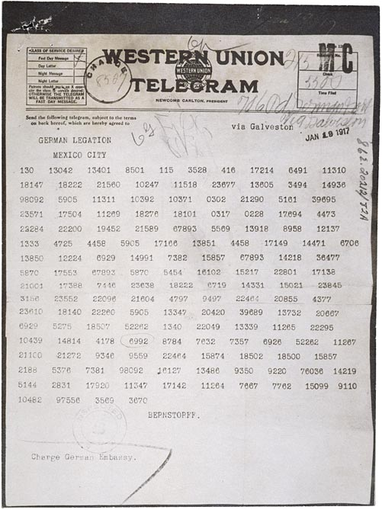
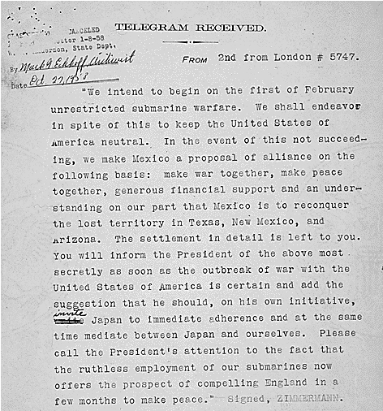
Zimmerman Telegram

Slide 20
Georgia and World War I
Georgia benefitted from several military training camps in the state.
Fort McPherson, south of Atlanta, was a permanent post. During the war it housed prisoners and treated thousands of soldiers in its hospitals.
Fort Benning was a major infantry training school.
Camp Hancock served as a weapons training school.
Demand was high for Georgia’s processed and canned foods. Cotton prices went up (military needed it).
Georgia’s textile mills made cloth for uniforms and bandages – this industry soared because of the war.
Many Georgia citizens bought Liberty bonds to help finance the war.

Slide 22
The End of the War
The Allies and Central Powers signed an armistice on November 11, 1918 (11th hour of the 11th day of the 11th month).
The Treaty of Versailles weakened Germany and created resentment and an economic depression in Germany that later brought on World War II.
Segregation continued after the war, to the disappointment of African Americans who had served in Europe.
Cotton prices dropped as less cotton was needed by the military after the war.

Slide 23
Return to Main Menu

